Slide 1

Examination in Art & Design?

Slide 2

The first thought leads to a feeling
of disbelief
“Wow, what is going on?
Are we putting the clocks back to the old Oxford A level days?

Slide 3

Art is supposed to be spontaneous and, perhaps, about questioning the old established structures

Slide 4


Slide 5



Slide 6

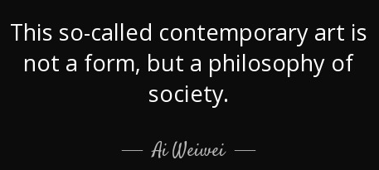

Slide 7


Slide 8

Young people respect rigour and the discipline of the new qualification.
This is what is frequently missing in their private lives.

Slide 9

It provides a way of thinking and critical understanding for their future professional progression.

Slide 10
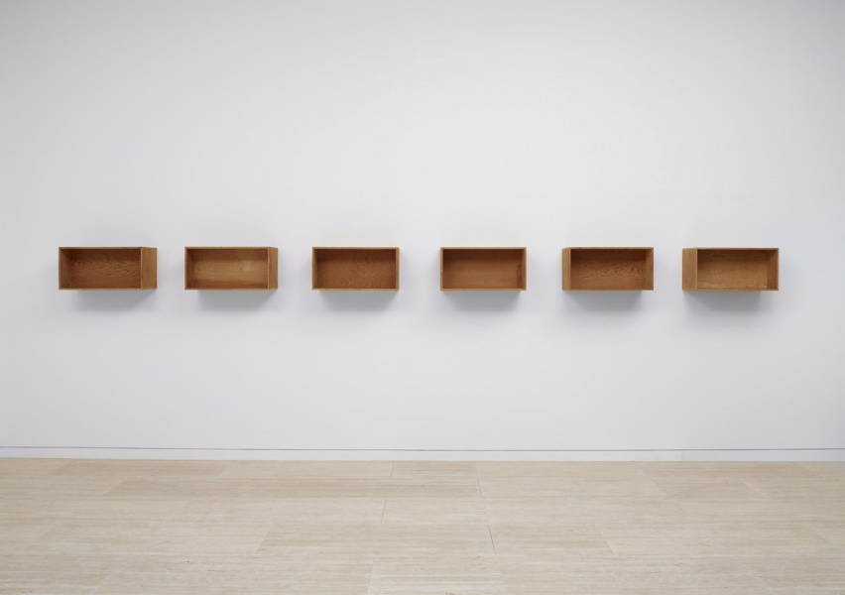
Demanding and structured year 1 leads to personalisation and ownership in the second year.

Slide 11

The exam has a high bar and the students have to be committed and focused in order to achieve.

Slide 12


External marking ensures fair and independent assessment,
not coloured by the relationship with individual students.

Slide 13

Students soon realise that the demanding nature of the exam gives them confidence in themselves and reinforces the value of the qualification.

Slide 14

Innovative design of the exam allows students to develop their personal projects, while responding to exciting, visual and stimulating brief.

Slide 15
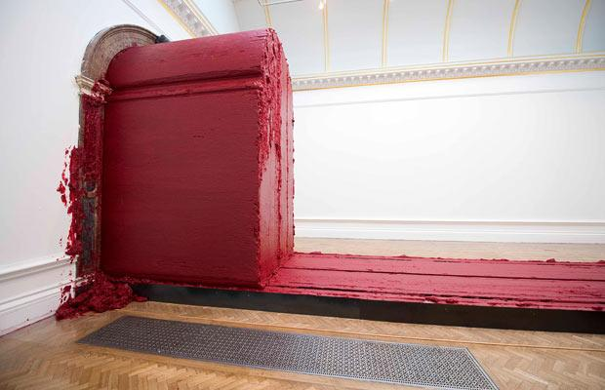
The course required thorough teaching and assessment in order to identify weaknesses and address them to prepare students for the exam and allow them to achieve.

Slide 16

The ethos of the
exam is on a deeply
reflective, critically analytical
and contextual appraisal of own practice and creative journey.

Slide 17

It is based on curation and understanding of their own work.

Slide 18

The training for the exam pays off in the second year.

Slide 19
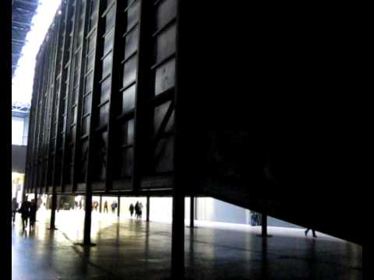
Students understand the importance of broad-ranging research, exciting experimentation and critical thinking and apply it to their own extended projects.

